Slide 1
Business and Industrial Economics
Prof. Luca Grilli
Externalities

Slide 2
Externalities: definition
An externality (spillover) is a cost or a benefit imposed upon someone by actions taken by others (with no compensation)
An externally imposed benefit is a positive externality
An externally imposed cost is a negative externality

Slide 3
Examples of Negative Externalities
Air & water pollution.
Loud parties next door.
Traffic congestion.
Second-hand cigarette smoke.
Examples of Positive Externalities
A well-maintained property next door that raises the market value of your property.
Network externality
Vaccines

Slide 4
Types of externalities
Consumption externalities
Consumption of a good by agent A has an impact on agent B’s utility
E.g., smoking, loud music, tidy garden of neighbour.
Network externality (2° part of the course)
Production externalities
Production actions by firm A have an impact on agent B’s utility/profit
E.g., bee-keeper and apple orchard, polluting firm and fisherman, etc.

Slide 5
Production externalities
a) negative
a) positive
Optimal Supply from social welfare point of view
Supply
Supply
Optimal Supply from social welfare point of view
External cost
Demand
External benefit
Demand
Optimal quantity for society
Quantity supplied in the MKT
Quantity supplied in the MKT
Optimal quantity for society
Overproduction
Underproduction
Welfare loss (blue triangle): Marginal private (= social) benefit of consumers (DD) exceeds marginal private costs suffered from firms (SS) but its inferior to the social marginal costs suffered from the society (which also includes external costs): producing those units has a cost which is larger than the benefit from a social welfare perspective
Welfare loss (blue triangle): Marginal private (= social) benefit of consumers (DD) is below marginal private costs suffered from firms (SS) but it is superior to the social marginal costs suffered from the society (which also includes external benefits): producing those units brings a benefit which is larger than the cost from a social welfare perspective

Slide 6
Consumption externalities
a) negative
a) positive
Supply
External cost
Supply
Optimal Demand from social welfare point of view
Demand
External benefit
Optimal Demand from social welfare point of view
Demand
Optimal quantity for society
Quantity supplied in the MKT
Quantity supplied in the MKT
Optimal quantity for society
Overproduction
Underproduction
Welfare loss (blue triangle): Marginal private (= social) cost of firms (SS) is below marginal private benefits of consumers (DD) but it is superior to the social marginal benefits of the society (which also includes external costs): producing those units has a cost which is larger than the benefit from a social welfare perspective
Welfare loss (blue triangle): Marginal private (= social) cost of firms (SS) is above marginal private benefits of consumers (DD) but it is inferior to the social marginal benefits of the society (which also includes external benefits): producing those units brings a benefit which is larger than the cost from a social welfare perspective

Slide 7
Externalities and Efficiency
Externalities cause welfare loss
too much resources are allocated to an activity which causes a negative externality (overproduction)
too little resources are allocated to an activity which causes a positive externality (underproduction).
The problem is one of “missing” markets (Coase)

Slide 8
Room-mates
2 agents A and B
There are two “goods”:
Stuff – i.e., money: m_{A} and m_{B} : Endowments = $100
Smoke – concentration: 0 ≤ s ≤ 1
A is a smoker: u_{A}(m_{A},s)
B is a non-smoker: u_{B}(m_{B},t), where t = 1-s
Note: s + t = 1

Slide 9
Edgeworth box
B’s money
Person B
s
Clean air
Smoke
Person A
m
A’s money

Slide 10
Rights Endowments
B’s money
Person B
s
If B has the right to a
smoke-free environment,
endowment is at
Smoke
Person A
m
A’s money
$100

Slide 11
Paying to smoke
B’s money
Person B
s
Allow trade, or
make A pay B per
unit of smoke
Contract curve
Smoke
Person A
m
A’s money
$100

Slide 12
Alternative Rights Alternative Endowments
B’s money
Person B
s
If A has the right to smoke
as much as he wants,
endowment is at
Smoke
Person A
m
A’s money
$100

Slide 13
Paying for clean air
B’s money
Person B
s
Contract curve
Allow trade, or
make B pay A per
unit of smoke
reduction
Smoke
Person A
m
A’s money
$100

Slide 14
Externalities and Property Rights
Ronald Coase’s intuition was that most externality problems are due to an inadequate specification of property rights and, consequently, an absence of markets in which trade can be used to internalize external costs or benefits.

Slide 15
Coase’s Theorem(s)
(weak version: efficiency proposition) When parties can bargain without cost (no transaction costs), the resulting outcome will be efficient, regardless of how the property rights are specified (e.g. Polinsky, 1974, pp 1665, ‘Economic Analysis as a Potentially Defective Product: A Buyer’s Guide to Posner’s Economic Analysis of Law’, 87 Harvard Law Review).
(strong version: efficiency + invariance propositions): When parties can bargain without cost, the resulting outcome will be efficient and the level of the externality generated the same, regardless of how the property rights are specified.
From Medema and Zerba 2000 (The Coase Theorem): “The Theorem has never been formally proved. Arguments regarding its correctness or incorrectness generally consist of attempts to demonstrate that it does or does not hold in a particular context or under a certain set of assumptions.” in the Encyclopedia of Law and Economics, Boudewijin and De Geest, Edward Elgar, 36-92.

Slide 16
Strong version generally not verified: A and B care about who gets the property rights and the level of smoke generated changes (from a theoretical point need of quasi-linear preferences)
B’s money
Person B
s
Contract curve
Smoke
Person A
m
A’s money
$100

Slide 17
Key message of Coase theorem is that Pareto improvements are possible to the extent that there are ways that allow the economic system to internalize the externality through market mechanisms
Trade among consumers (Edgeworth box example)
Merging of firms (steel mill vs. fishery example)

Slide 18
The «market signal» for Merging
Steel mill & Fishery: price takers
Scenario A: separate
Steel mill: max π (S, x) = p_{s}S - C_{s} (S, x)
Suppose C_{s} (S, x) = S² + (x-4)² and p_{s}=12.
F.O.C₁ (∂π/∂s) =0; S* = 6
F.O.C₂ (∂π/∂x) =0; x* = 4
π_{S} = 36
Fishery: max π (f, x) = p_{F}f - C_{F} (f, x)
Suppose C_{F} (f, x) = f² + xf and p_{F}=10.
F.O.C (∂π/∂f) =0; 10 -2f*- x = 0; f* = 5 - (1/2)x
Given the choice of x*=4 by Steel mill, f* = 3.
π_{F} = 9
π_{S} + π_{F} = 36 + 9 = 45.
Scenario B: merged. Now a merged firm max π (s, f, x)
What is the global profit?

Slide 19
Merger: Steel mill + fishery: max π (S, f, x) = 12S + 10f - S² - (x-4)² - f² - xf
F.O.C₁ (∂π/∂s) =0; S^{M} = 6
F.O.C₂ (∂π/∂f) =0; 10 -2f*- x = 0; x^{M} = 10 – 2f^{M}
F.O.C₃ (∂π/∂x) =0; -2(x^{M}-4) – f^{M} = 0
Substituting F.O.C₂ in F.O.C₃: x^{M} = 2 and f^{M} = 4
π_{M} = 48 while in scenario A it was π_{S} + π_{F} = 36 + 9 = 45.
Intuition: Is the market through the profit signal that provides the incentive to the steel mill to merge with the fishery. The merged firm by taking also care of the social cost of steel production makes everybody better off.
Scenario A: S* = 6; x* = 4, f* = 3, π_{S} + π_{F} = 45
Scenario B: S^{M} = 6; x^{M} = 2, f^{M} = 4 , π_{M} = 48
The Steel mill now cares about the damage provoked on the fishery:
In scenario A, Steel mill F.O.C₂ (∂π/∂x) =0 (∂C_{s}(S, x)/∂x) =0
In scenario B, Steel mill F.O.C₃ (∂π/∂x) =0 (∂C_{s}(S, x)/∂x) +(∂C_{F}(f, x)/∂x) =0

Slide 20
But assignment of property rights and trade (Coase theorem) or redistribution of property rights (Merging) as a way to solve externality problems hinges upon small numbers involved, absence of bargaining (transaction) costs and/or the ability of the firms to recognize profit market signals and act accordingly
Numbers involved are often very large (externalities affect whole society), bargaining costs are extremely high, the merge between a steel mill and a fishery is far from being obvious, or simply the level of pollution considered too high for the whole economic system even after merging.
Real world
Public policy has a more invasive role than just assigning property rights or leave the market exploit profit signals

Slide 21
What to do if Coase theorem/profit signals mechanism breaks down?
Command & Control
Pigouvian taxes (or subsidy)
Tradeable permits (“artificial” markets in the spirit of Coase)
[On the superiority of TP (when applicable) see the example on Mateer and Coppock on Principle of microeconomics, Chapter 7, summarized in the next slide]

Slide 22
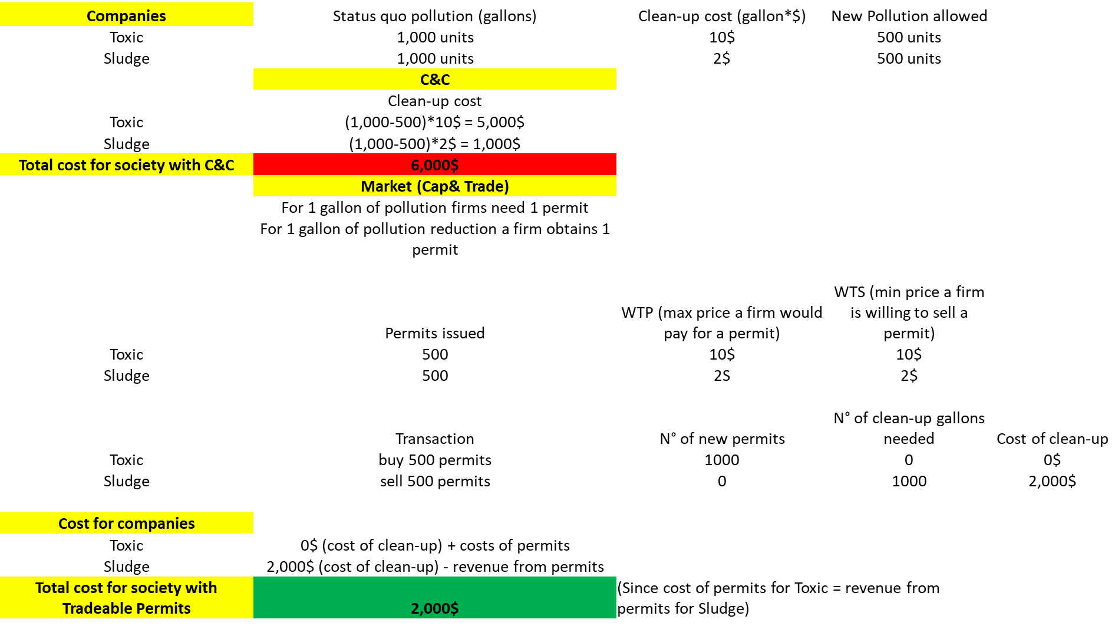

Slide 23
References
Varian (Intermediate Microeconomics, chapter 35: 35.1, 35.2, 35.3, 35.4, 35.5).
Further (optional) reading (ever-green classic):
R. Coase, The problem of social cost, Journal of Law and Economics, Vol. 3 (Oct., 1960), pp. 1-44.

